Slide 1
INTEGRATED FACE DETECTION AND TIME-STAMPED ATTENDANCE MONITORING
PAPER ID : 81
Manoj Kumar K
Dept. of Computer Science and Engineering(AI & ML)
Srinivasa Ramanujan Institute of Technolgy
Anantapuram
224g5a3308@srit.ac.in

Slide 2
Contents:
Aim
Objectives
Abstract
Literature survey
Existing models
Proposed Designs/models
Block diagram/Flow chart
Comparative Analysis
Result
Conclusion & Applications
References

Slide 3
Aim:
The aim of this project is to develop an automated face recognition-based attendance system that efficiently tracks attendance without manual intervention.
The system captures images through a camera, detects and recognizes faces using machine learning algorithms, and marks attendance in an Excel sheet or database.
By eliminating traditional methods like roll calls or RFID cards, this project improves accuracy, reduces time consumption, and prevents proxy attendance.
It is particularly useful in educational institutions and workplaces, ensuring a fast, reliable, and secure way to maintain attendance records while enhancing overall productivity and efficiency.

Slide 4
Objectives :
1. Automated Attendance System – Develop a face recognition-based system that eliminates manual attendance marking, reducing time consumption and human errors. 2. Real-Time Face Recognition – Implement an efficient facial recognition model that can detect and recognize individuals in real-time under varying lighting conditions and angles. 3. Accuracy and Security Enhancement – Ensure high accuracy in attendance tracking by using advanced machine learning techniques while preventing fraud such as proxy attendance. 4. Seamless Integration – Enable easy integration with databases, i.e, Excell Sheet for secure attendance record management. 5. User-Friendly Interface – Develop an intuitive and accessible system that requires minimal technical knowledge for operation.

Slide 5
Abstract:
Using technology for attendance systems is usually time-consuming and error-prone. Managing students and entering data of bulk students can be a time-consuming process and prone to data entry errors. In this purpose, we have designed a System to integrate face Detection and time-stamped based system which makes use of face detection and face recognition techniques to avoid the manual way of data entry. For face detection, we use HOG + SVM or CNN based and for face recognition, we use Deep Metric Learning (ResNet-34). It performs a face matching using Euclidean distance based face matching to the match detected faces to a database of stored faces thus producing a very good accuracy of face identification. This model is implemented in python using openCV and face_recognition libraries. In addition, it implements an auto attendance mechanism by using OpenPyXL library to input real time data into a Excel sheet. GUI based on Tkinter is included to improve the usability, monitor attendance in real time and track attendance. This flawless and secure identification makes the system a good recommendation for schools, organizations, and access control. This solution replaces manual entry of attendance therefore making attendance more efficient and minimizing errors while providing a practical output and automatic way of addressing attendance issues for different scenarios

Slide 6
Literature survey:
1. Automated Attendance System Using Face Recognition by Akshara Jadhav (2017):
This study presents an automated attendance system using face recognition with PCA, achieving optimal recognition even with appearance changes, though further improvements are needed for real-time robustness.
2. Face Recognition-Based Attendance Marking System” by Senthamil Selvi et al. (2014):
This research proposes a face recognition-based attendance system that enhances security and efficiency. It uses skin classification for accuracy and stores data on a server, though a portable module is suggested for portability.
3. Implementation of an Automated Attendance System Using Face Recognition” by Mathana Gopala Krishnan et al. (2015):
This paper introduces an automated attendance system using the Eigenface algorithm for face verification. It reduces faculty workload, improves accuracy over time, and enhances efficiency by minimizing human intervention in tracking attendance.

Slide 7
Existing models:
The existing system for attendance tracking typically relies on manual methods such as roll calls or swipe cards, which are time-consuming and prone to errors.
While some automated systems use RFID or barcode scanning, these methods still require physical interaction, making them less efficient.
Face recognition-based attendance systems, although available, often face limitations in accuracy, especially under varying lighting conditions and multiple face detections.
Additionally, integration with existing systems, such as real-time logging and managing large datasets, remains a challenge.
These systems may also lack advanced features such as live monitoring and user-friendly interfaces for administrators.

Slide 8
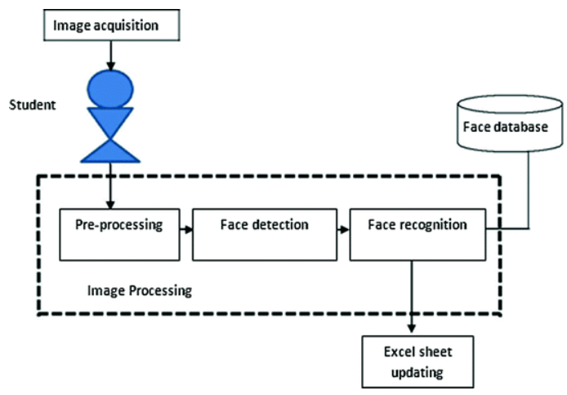
Design methodology:
Image Acquisition
A camera captures real-time images or video frames when a student or employee enters the designated area.
2. Preprocessing
The captured images undergo enhancement, resizing, and conversion to grayscale for better accuracy.
Figure : Block diagram of Proposed System

Slide 9
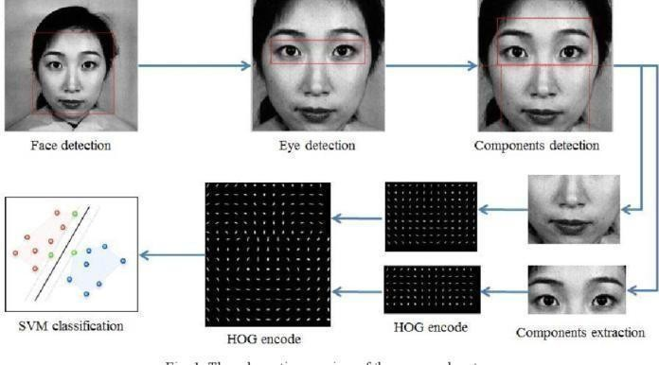
Design methodology:
3. Face Detection
The system detects faces in the image using algorithms like Haar Cascade or HOG (Histogram of Oriented Gradients).
4. Face Recognition
Recognized faces are compared with stored facial embeddings in the database using ResNet-34.
5. Attendance Marking
If a match is found, attendance is recorded with a timestamp in an Excel sheet.
Figure : Human Facial Detection using HOG encoding and SVM Classification

Slide 10
Comparative Analysis:
Feature | Traditional Attendance System | RFID-Based Attendance | Face Recognition-Based Attendance
Automation | Manual | Semi-automated | Fully automated
Accuracy | Prone to human errors | Moderate | High accuracy with AI
Security | Low (Can be faked) | Moderate (RFID cards can be shared) | High (Unique facial features)
Hardware Requirement | Pen, paper, or register | RFID readers, cards | Camera, computer, database
Cost | Low | Medium | Higher initial investment but cost-effective in the long run
Scalability | Limited | Moderate | Highly scalable
Time Efficiency | Time-consuming | Faster than manual | Very fast and real-time
Integration with Other Systems | Difficult | Possible | Easy to integrate with databases, cloud, and IoT

Slide 11
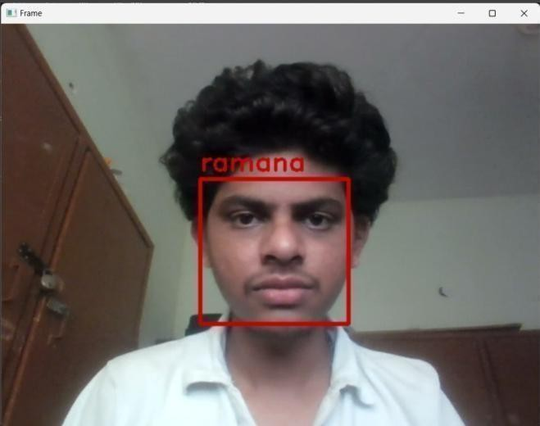
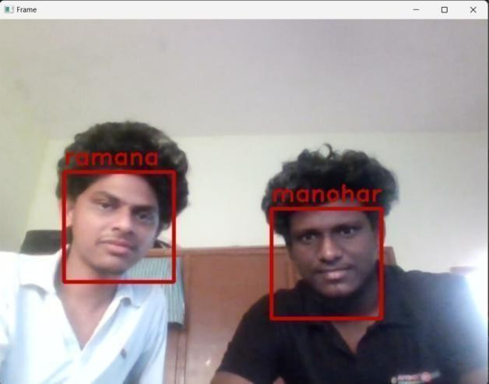
The system can detect single or multiple faces and processes them by resizing or converting them to grayscale. It then analyzes each face using algorithms like ResNet34 or HOG, generating facial embeddings to compare against a pre-stored database. If a match is found, the system records the person’s attendance with a timestamp in an Excel file. For multiple faces, it automatically marks attendance for each detected individual. If no match is found, a “No Match” status is recorded. The resulting attendance data is stored in an Excel file, making it easy to track, export, and report for administrative purposes.
Result:
Figure : Single Face Detection
Figure : Multiple Face Detection

Slide 12
Conclusion:
The face recognition-based attendance system automates attendance marking with high accuracy using ResNet-34 and HOG with SVM. It reduces manual errors, enhances security, and integrates with Excel for easy record-keeping.
This system ensures efficient, real-time identification, making it a reliable solution for educational institutions and workplaces.

Slide 13
Applications:
Security and Surveillance Systems
Smart Authentication Systems
Healthcare and Patient Monitoring
Human-Computer Interaction (HCI)
Driver Monitoring in Autonomous Vehicles

Slide 14
Refernces:
Hajar Filali Jamal, Riffi Adnane Mohamed Mahraz, Hamid Tairi, "Multiple Face Detection Based on Machine Learning," 978-1-5386-4396-9/18/$31.00, 2018 IEEE.
Ravi Kumar, S. Gupta, "Enhanced Face Recognition for Automated Attendance Using CNN," 2019 IEEE International Conference on Computer Vision and Pattern Recognition, 2019 IEEE.
Maria Lopez, Carlos Fernandez, "Face Embedding Techniques for Accurate Attendance Systems," Proceedings of the 2020 IEEE International Conference on Big Data, DOI: 10.1109/BigData50027.2020.00123, 2020 IEEE.
Anil Kumar, Sunita Patel, "Robust Face Detection and Recognition Using Transfer Learning," 2020 IEEE 5th International Conference on Advanced Computing and Communication Systems, 2020 IEEE.
Ling Wei, Zhenyu Zhang, "Optimizing Facial Recognition Accuracy in Crowded Environments," Journal of Real-Time Image Processing, Vol. 17, No. 3, 2021, DOI:10.1007/s11554-021-01023-8.

Slide 15
Thank you

